Slide 1
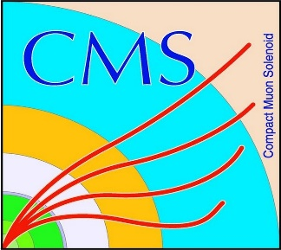

HEP Weekly Report
George Bakas
NTUA

Slide 2
Progress Report
DCS
fwInstallationUtils
Using the dbEditorAndNavigator tool to create projects using installations db
Want to implement ownership rights when using the tool
Progress on the tool
Now all projects, computers, systems and groups are monitored for each specific user when using the tool
Several changes in the panels and scripts to implement tool
ArdEnvino
Box has some issues
Fixed and waiting for the new model

Slide 3
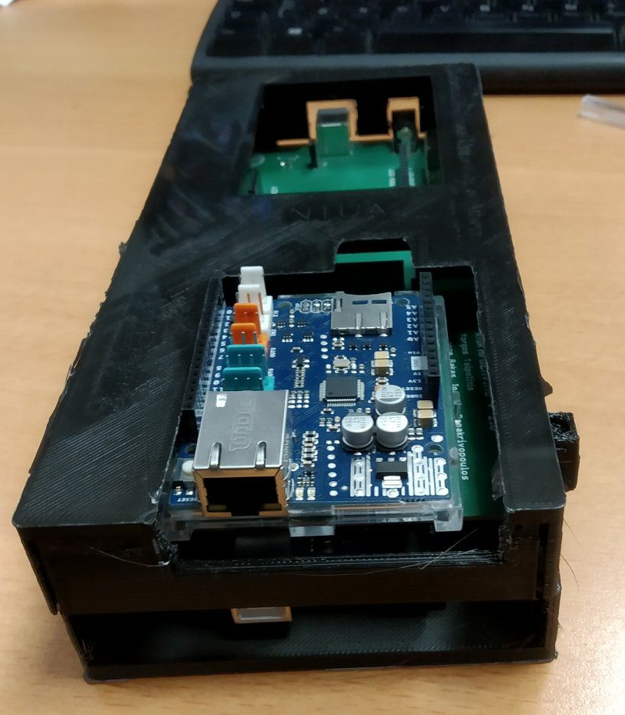
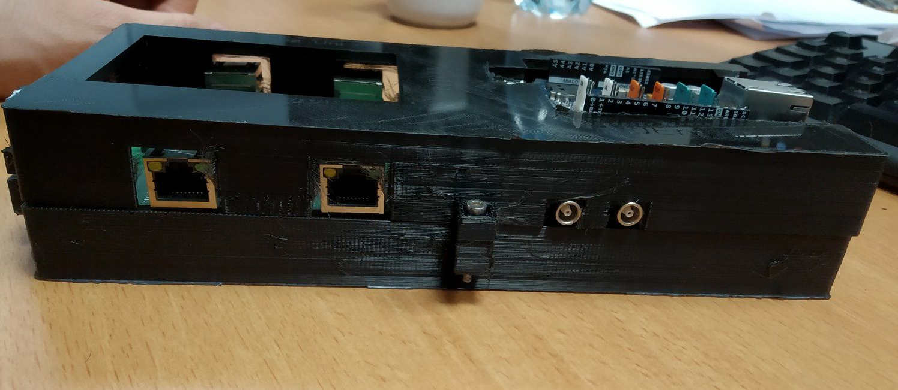
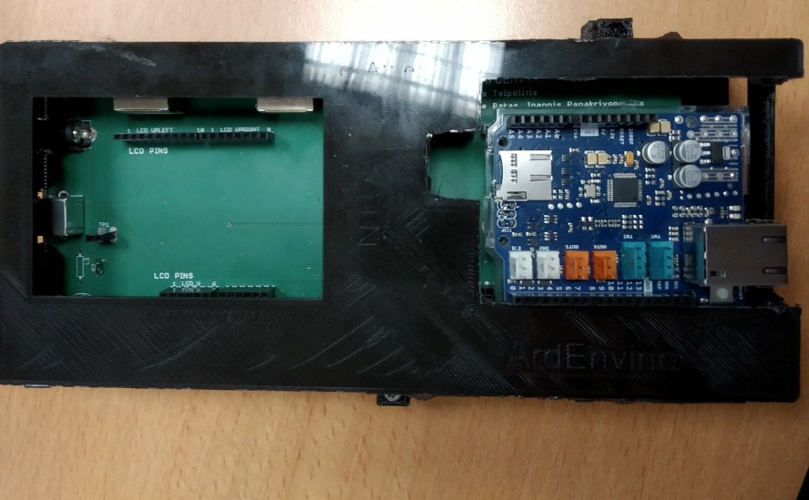
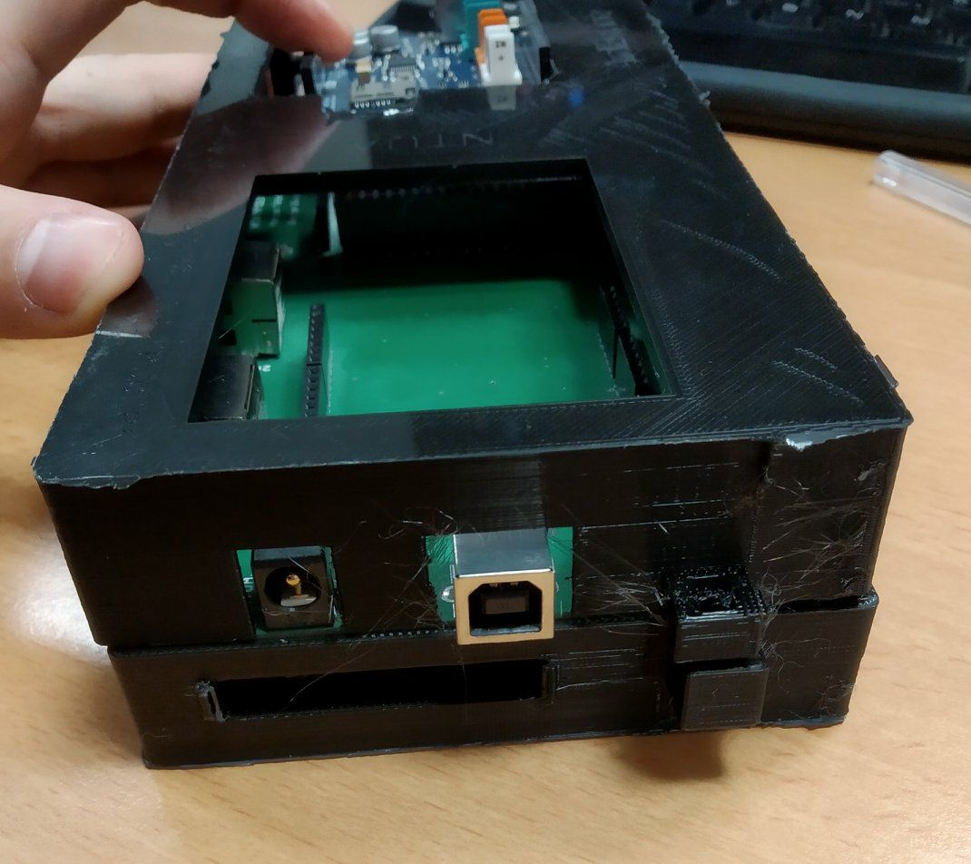

Slide 4
Analysis
Top Spin Correlation
Sample is requested for all the ttbar final states
Top Tagger efficiency, signal/bkg
Working with Giannis to calculate efficiencies for 5 selection categories
Category 1: Both jets are b-tagged and top tagged
Category 2: 1 jet is b-tagged and top tagged and the other jet is at least top tagged
Category 3: 1 jet is b-tagged and top tagged and the other jet is at least b-tagged
Category 4: both jets are top tagged
Category 5: both jets are b-tagged
Did this for:
Mtt samples (samples with mtt mass cut)
Nominal ttbar sample
Bkg samples
Signal over Bkg
Measure the signal yield/ bkg yield, where yield = sum(all slices)((xsec_i x selectedEvents_i x Luminosity )/Generated_Events)
Top-18-013 analysis
New Mtt samples
Calculate response matrices and extrapolation factors to see that there are no discrepancies in the mtt samples with the nominal sample that was used in the analysis

